Slide 1
Name: Muhammad Ashraf Roll No: 19SW19 Subject: Data Structures and Algorithms Project: Student Email GUI

Slide 2
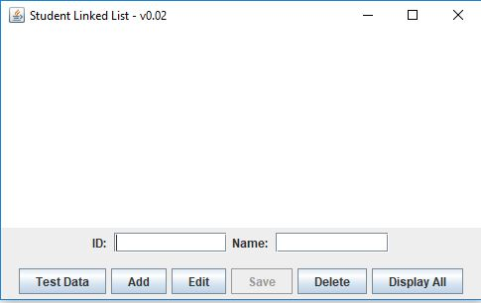
INTRODUCTION:
Student Email GUI.
The data Structure that is used is LinkedList.
Functionalities:
Add
Save
Delete
Edit

Slide 3
IDENTIFICATION OF PROBLEM:
My Project is on Student Email GUI.
Which stores or keeps student email in its data base and also have some functionalities:
As Email can be saved, deleted, or edited by its Id.
So for this purpose I have need of Data Structure to store, save, delete, or edit the email with the help of its Id.

Slide 4
Which Data Structure is needed:
In this project we have to store, save, add, edit or delete email so for this purpose I considered the LinkedList Data Structure best for this purpose. Because Id and name of the student is connected with the email. So I prefer LinkedList data Structure whereas other data Structure are not that suitable for this purpose.

Slide 5
Why Data Structure is Used:
Data Structure is necessary for all those projects which stores its data.
Data Structure is needed to shape particular data in an organized manner.
So in my Project also Data Structure is necessary because this project stores, add, save, edit or delete email so for this purpose data Structure is needed because this all can be done easily through a Data Structure.

Slide 6
COMPLETENESS OF PROJECT:
My Project have all functionalities:
Add
Save
Delete
Edit
All these functionalities are working properly.

Slide 7
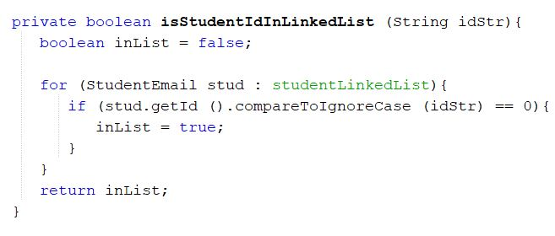
Code:

Slide 8
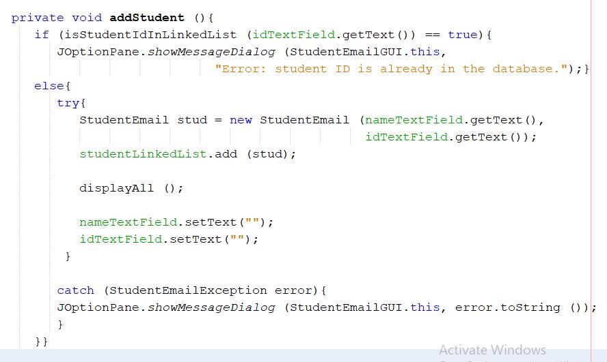
Code:

Slide 9
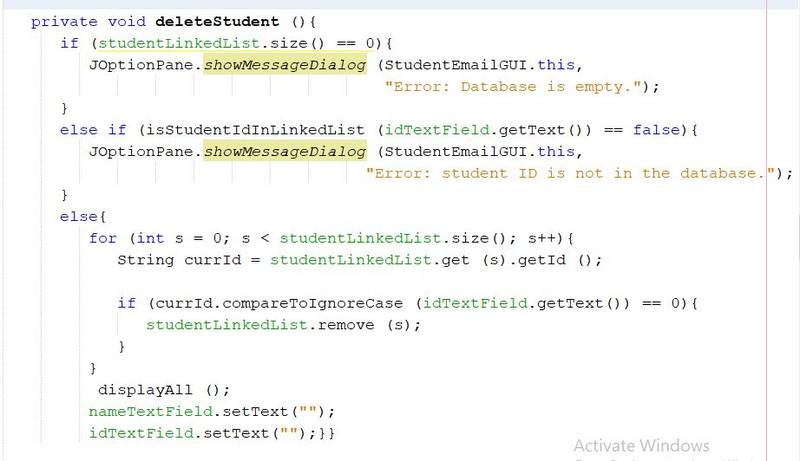
CODE:

Slide 10
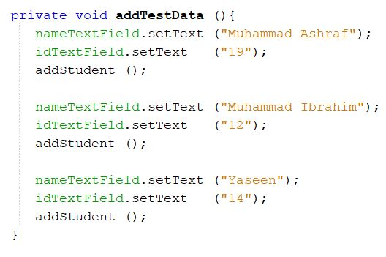
CODE:

Slide 11
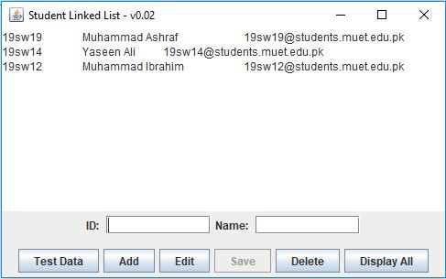
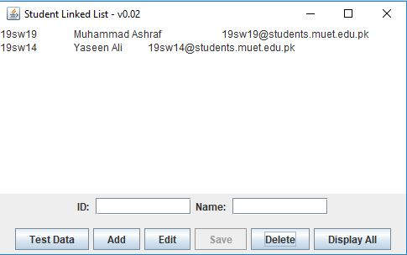
OUTPUT:
ADD DELETE

Slide 12


